Slide 1
Building a Statewide Learning Healthcare System in CT
Vinod Srihari, MD
Notes:
- Welcome
Ground rules – plan to record for future educational purposes, please let us know if you have any concerns
Please put questions in the chat as they come up, we will address them in the discussion time at the end of the session
Introduce self in the chat – Name, Agency, Role
Introduce Laura and Vinod

Slide 2
Outline
Rationale & Evidence for Early Intervention Services
Addressing unmet need in Connecticut: a statewide Learning Health System

Slide 3
Early Intervention Services
Rationale and Evidence

Slide 4
Schizophrenia(s): The Critical Period &
Opportunities for Early Intervention
Phase of illness
Premorbid Prodrome Acute Plateau / Chronic
A (8-16%)
Most of the clinical and psychosocial deterioration occurs in first 5 years
Onset of illness
B
First episode
Critical Period
Functioning
De-synchrony of symptoms and functioning: phases are different
C (8-9%)
DUP
Prognostically important period: Symptom duration in first 2 years is strongest predictor of outcome; Highest Suicide risk; Onset of substance misuse;
Longer Duration of Untreated Psychosis associated with poorer outcomes
Age (years)
5 | 10 | 15 | 20 | 25 | 30 | 35 | 40 | 45 | 50 | 55 | 60
from Srihari et al. Psych Clin of N America, 2012
Notes:
Early Turbulence: Relapse rates of 43% (1 year), 55% (two years) and 70% (5 years).(4) two-thirds of completed suicides within six years of onset (5)
Middle period of ‘plateau’: A landmark prospective early psychosis study of 90 patients with low attrition over 10 years confirmed a steep decline to a stable 20-25% prevalence of residual positive or negative symptoms within two years of onset.(9)
Late recovery: A recent meta-analysis of longitudinal studies of first-episode psychosis confirmed that the proportion of patients with poor outcomes does not increase over time (14).

Slide 5
Schizophrenia(s): ‘chronic diseases of the young’
Less than 1/3 ‘recover’ over 5 years in usual care systems (Menezes, Psychol Medicine ’06)
Costs: ~$156 billion. Direct* (24%); indirect (76%) ** (Cloutier, J Clin Psychiatry ’16)
*mostly (re)hospitalizations; **mostly unemployment, caregiving
(Affective d/o: $210.5 billion)

Slide 6
Early Intervention (EI): current best practices in CT
Phase of illness
Premorbid Prodrome Acute Plateau / Stabilization Recovery
A (8-16%)
Onset of illness
B
First episode
Functioning
PRIME
(Prodrome Research Clinic)
C (8-9%)
(Chronic) Continuum of Care (e.g Office, ACT, CSP)
STEP’s EIS
Age (years)
5 | 10 | 15 | 20 | 25 | 30 | 35 | 40 | 45 | 50 | 55 | 60
from Srihari et al. Psych Clin of N America, 2012
Notes:
Early Turbulence: Relapse rates of 43% (1 year), 55% (two years) and 70% (5 years).(4) two-thirds of completed suicides within six years of onset (5)
Middle period of ‘plateau’: A landmark prospective early psychosis study of 90 patients with low attrition over 10 years confirmed a steep decline to a stable 20-25% prevalence of residual positive or negative symptoms within two years of onset.(9)
Late recovery: A recent meta-analysis of longitudinal studies of first-episode psychosis confirmed that the proportion of patients with poor outcomes does not increase over time (14).

Slide 7
The Evidence for EIS: Summary
ED: Intervening earlier (even without enriching care) appears to have durable effects on outcome (Hegelstad et al, 2012)
B. FES: Intervening intensively after the onset of psychosis improves outcomes over usual care (OPUS, Lambeth, STEP and RAISE studies) at 2+ years (Correll et al., 2018)

Slide 8
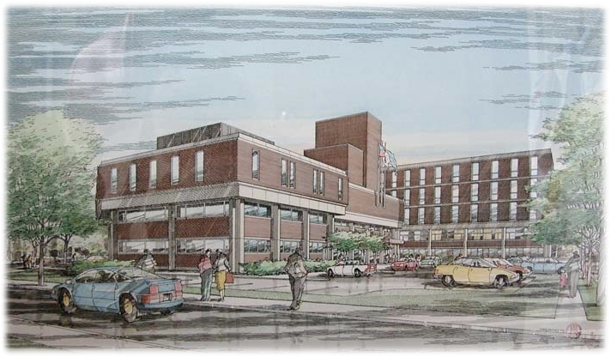
The Clinic for Specialized Treatment Early
in Psychosis (STEP) est. 2006
Pragmatic RCT (2007-’13)
Broad recruitment
Feasible interventions
Relevant outcomes
Based in public sector
CMHC: DMHAS-Yale partnership
Addressed barriers to access
Insurance status
Catchment of residence
Adolescent-Adult

Slide 9
REFERENCE POPULATION
Individuals in early stages of psychotic illnesses in CT ~400-500/yr
The STEP Trial
2007-‘13
ClinicalTrails.gov NCT00309452
NIH MH088971-01
SOURCE POPULATION
Referrals from ~
-CMHC triage
-Private Hospitals/ERs
-Area Clinics/PRIME
-Colleges
Age: 16-35 yo
Duration of illness: ≤12wks lifetime antipsychotic Rx AND <5yrs illness
Exclusion: sub-induced psychotic d/o
Exclusion: DDS (DMR) eligibility
STUDY POPULATION
TAU
Referral to private or public-sector care
STEP Care
Based within CMHC ambulatory services

Slide 10
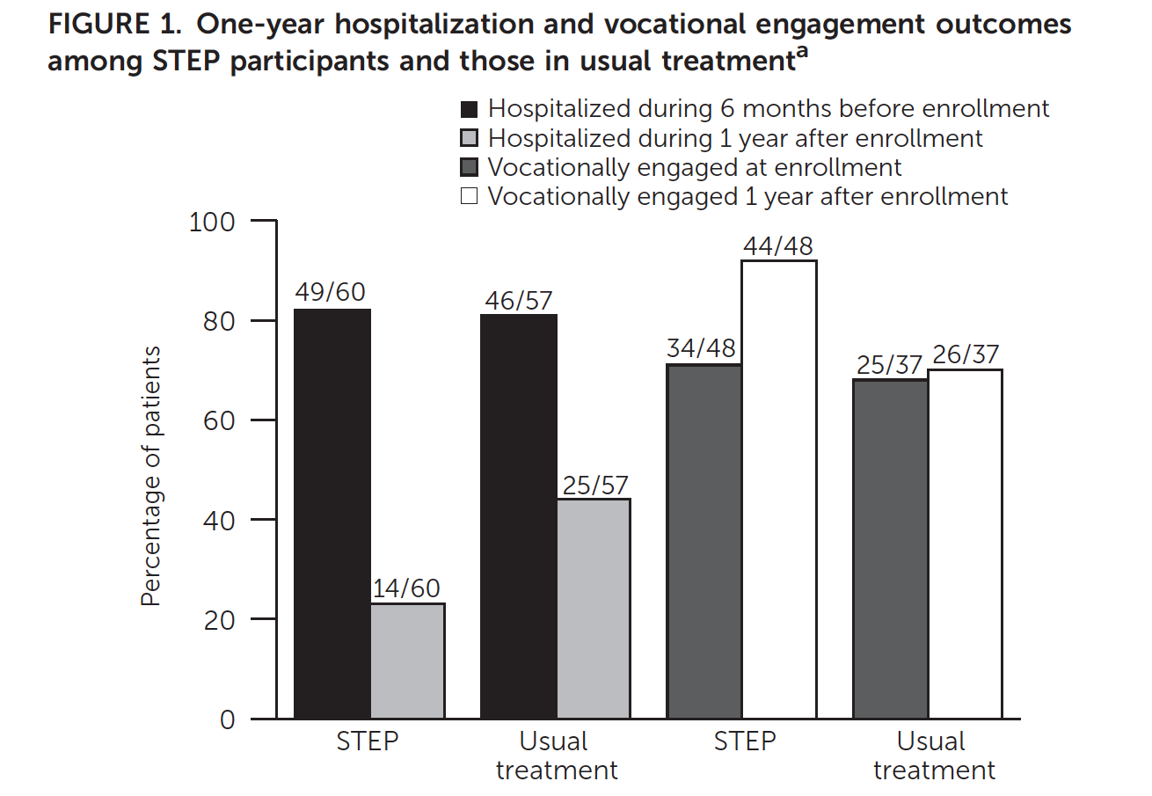
Srihari et al., Psych Services 2015
STEP care is effective (vs TAU)
NNT of 5 for Hospitalization over first year
Fewer in STEP had ‘dropped’ out of labor force 8% (vs. 33% in Usual Treatment)

Slide 11
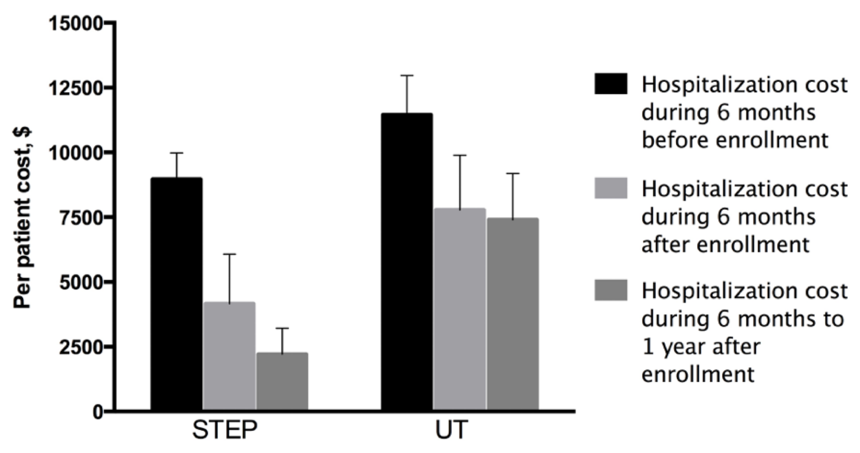
STEP progressively reduced frequency, duration of acute hospitalizations
STEP Care has cost benefits
Murphy et al., J of Mental Health Policy and Economics, 2018

Slide 12
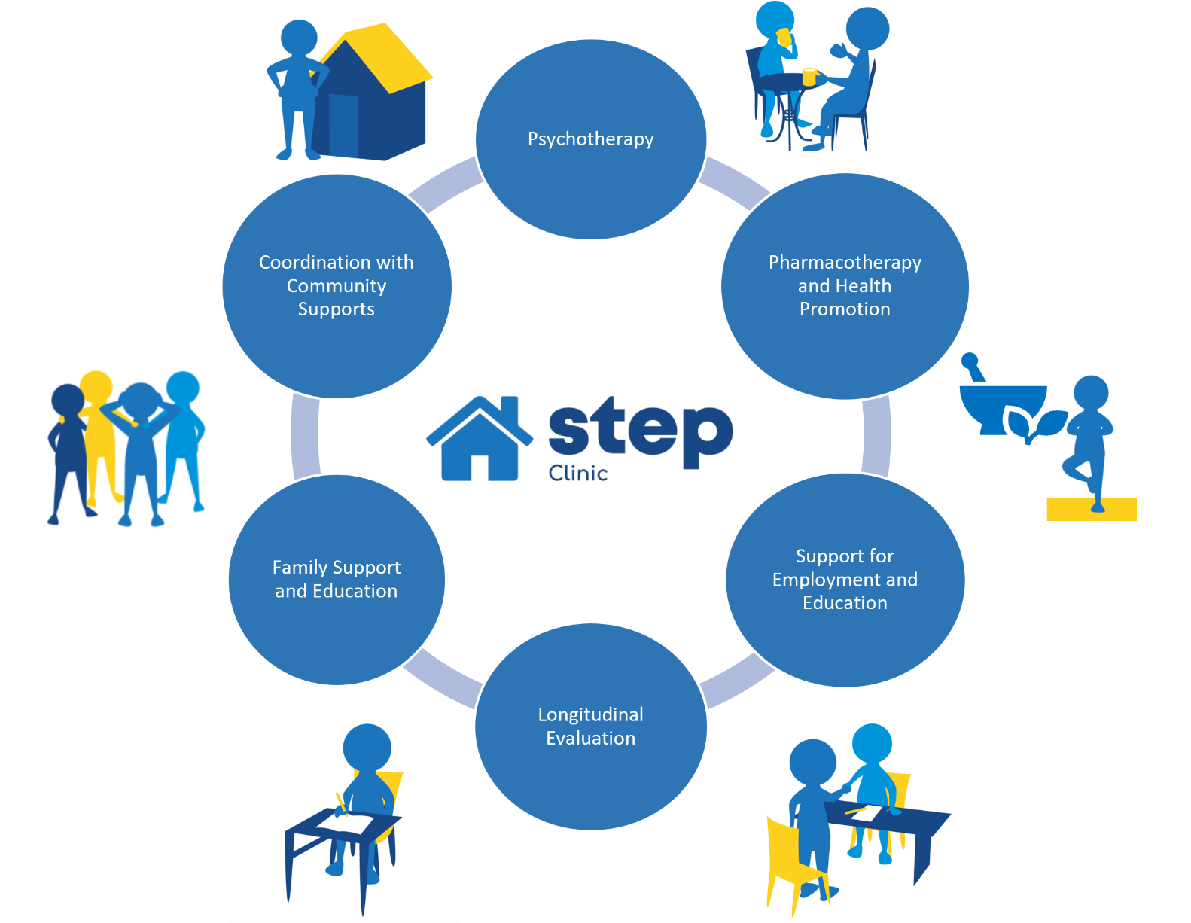
STEP Elements of Care
Phase Specific:
Acute/Engagement
Stabilization
Recovery
Notes:
Model of care can be broken down into 6 main components, all tailored to the individual based on their stage of illness, presentation, and preferences
Going to briefly outline the elements

Slide 13
Evolution of the evidence for FES or
Coordinated Specialty Care (CSC) in early psychosis
Efficacy (can it work?) ✔ LEO (U.K.), OPUS (Denmark) (high intensity ACT level services) 2005
Effectiveness (does it work?) ✔ STEP, RAISE-Navigate (pragmatic office-based services) 2015
Costs (is it worth the cost?) ✔ STEP, RAISE-Navigate
Dissemination (is it scalable?) ✔ (UK, Denmark)
USA….?
Notes:
Sufficient uncertainty about effectiveness, costs, feasibility to plan a trial

Slide 14
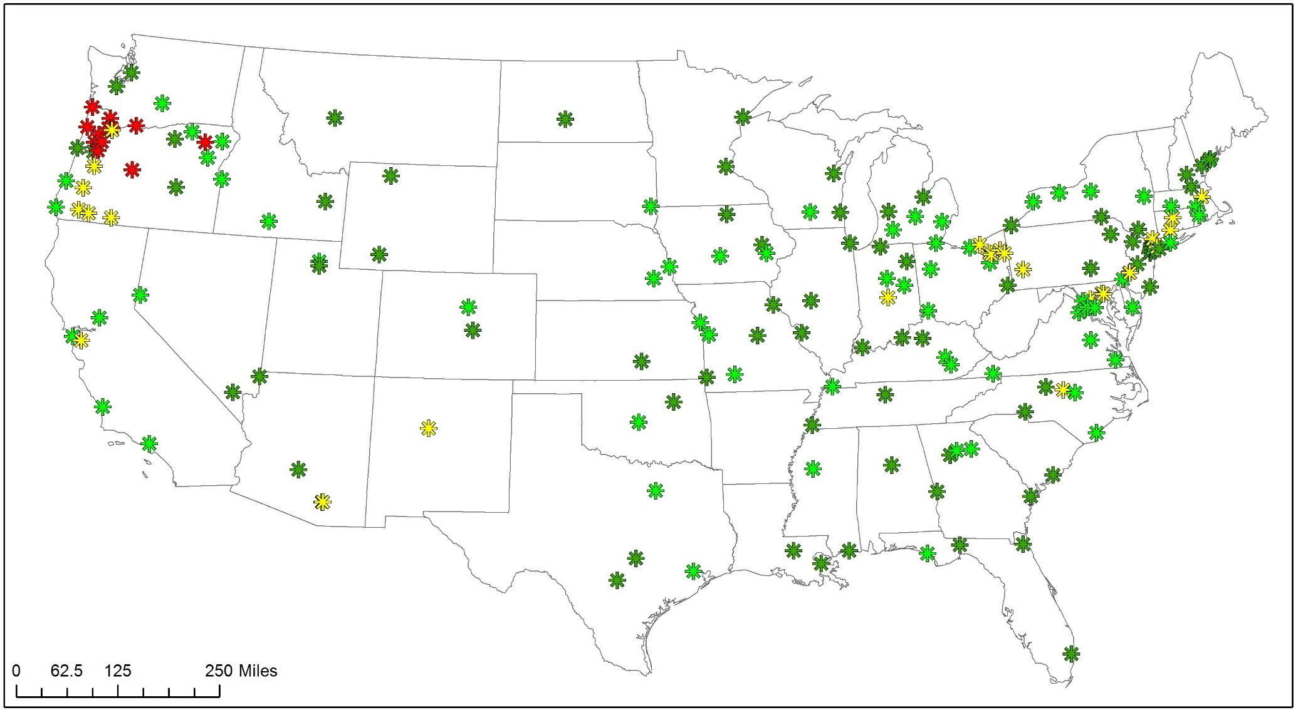
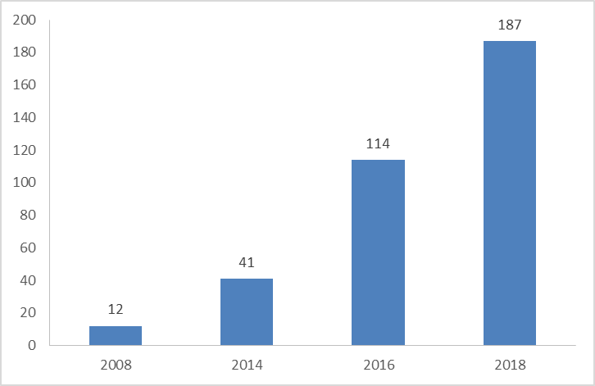
The Rapid Implementation of CSCs across the US
Rapid Growth of CSCs in US
2008
2014
2016
2018
from Robert Heinssen, NIMH

Slide 15
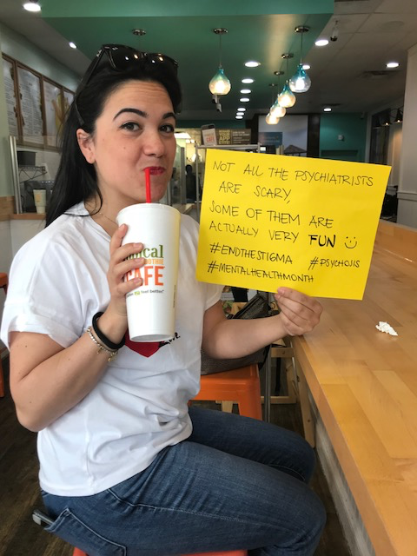
Mindmap
Reducing DUP: The Mindmap campaign
Lt. Murgo, East Haven Police Department
Testing Early Detection
Feb. 2015- Feb. 2019
Maria Ferrara, MD: Non-scary Psychiatrist

Slide 16
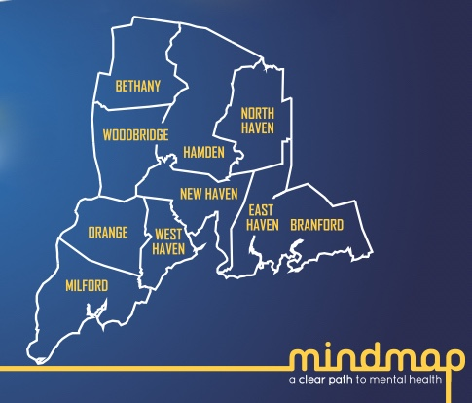
PREP / (CEDAR)²
STEP/ (PRIME)
Metropolitan Boston
Population: 646,000
Area: 232.1 km²
New England’s Early Detection initiative
The STEP-ED Study (NIH) 2014-2019
Reducing DUP via media, outreach and performance improvement
10 Towns
Population: 408,874
Area: 506 km²
Srihari et al., BMC Psychiatry 2014

Slide 17
Mindmap: 3 interleaved components
Public Education Campaign (Social and Mass Media)
Professional Outreach & Detailing
Wait-time reduction

Slide 18
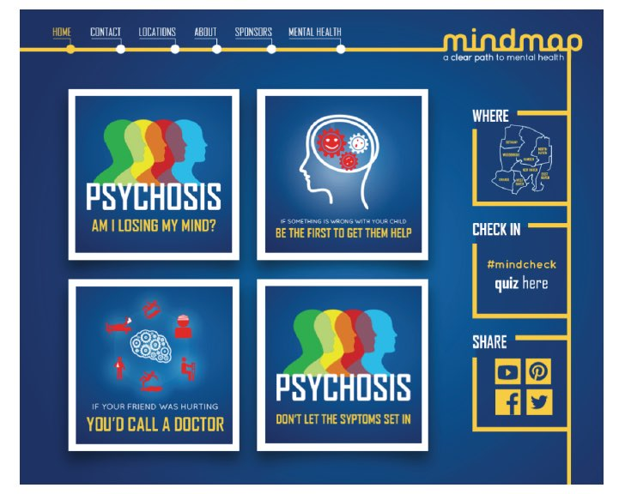
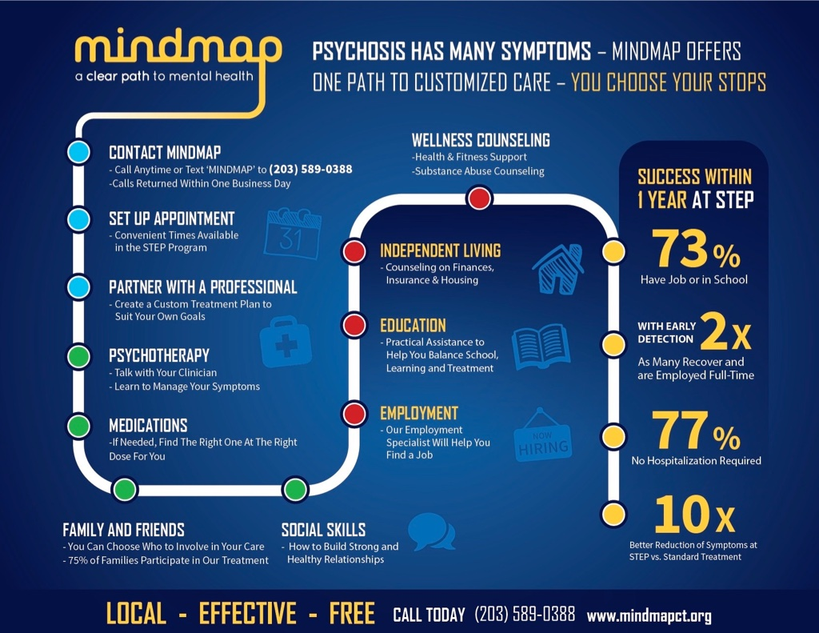

Slide 19
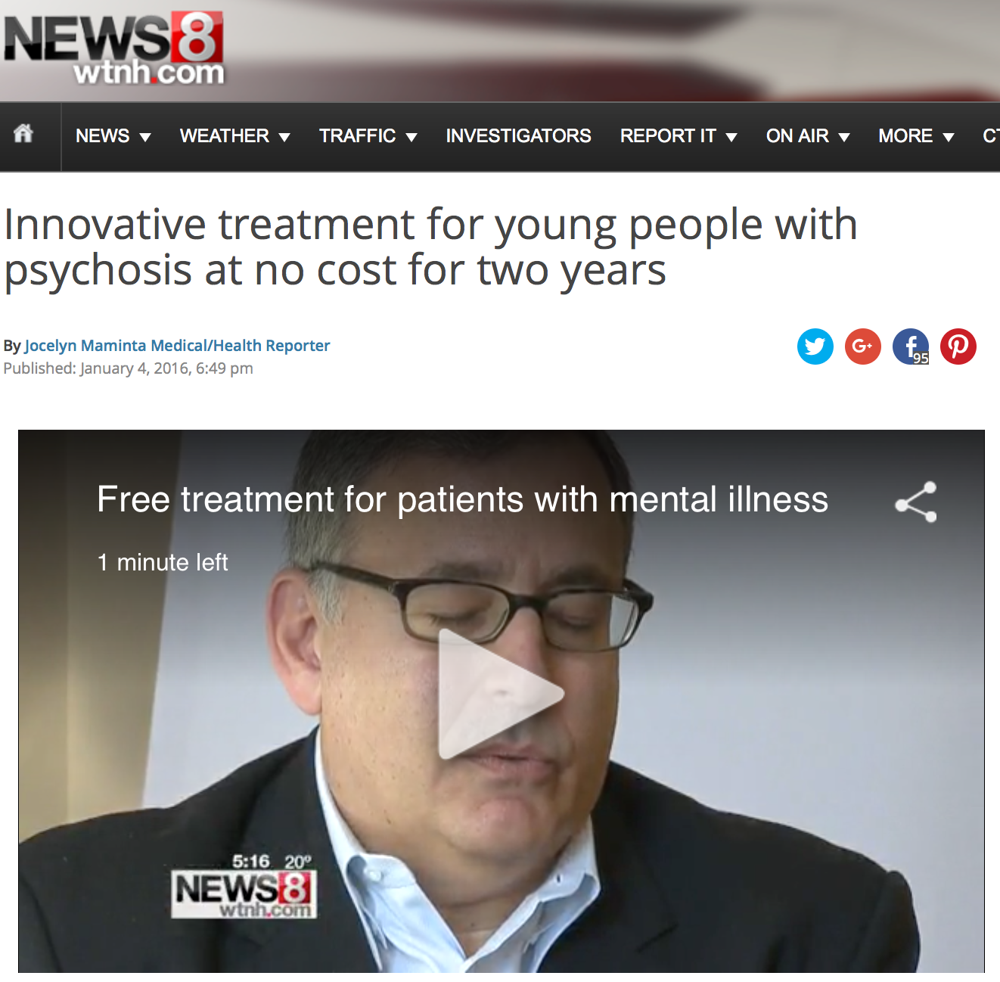
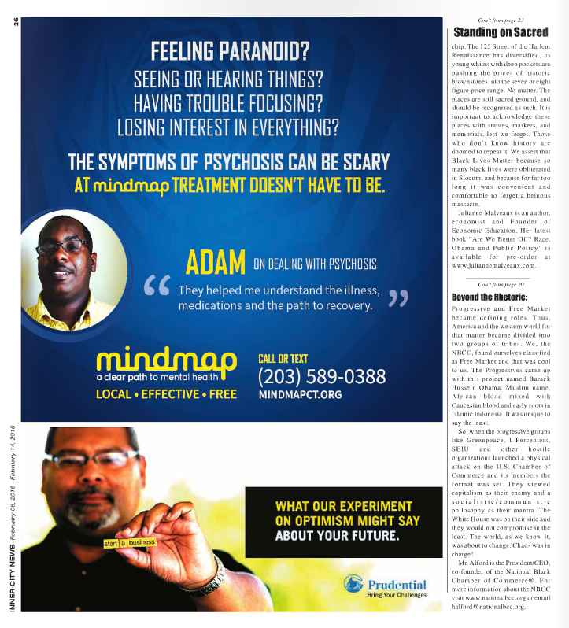
Integrating mass & social media: multiple channels with
clear call to action

Slide 20
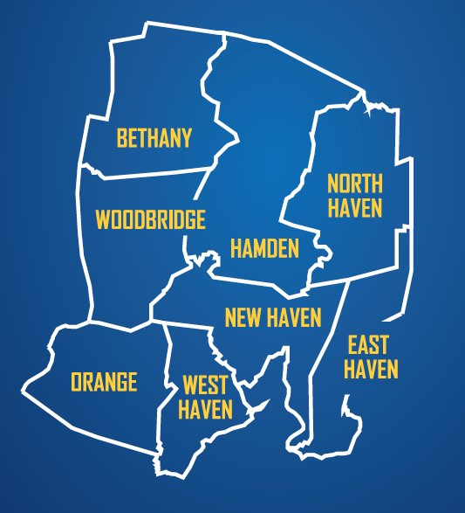
Professional Outreach & Detailing
Judicial
Police/Probation
Social
Services
Public
Charity/Clergy
Primary Care
Hospital
Education
Mental Health
Services
Consumer/
Youth/Orgs.
Branches of
Government

Slide 21
Outreach and detailing

Slide 22
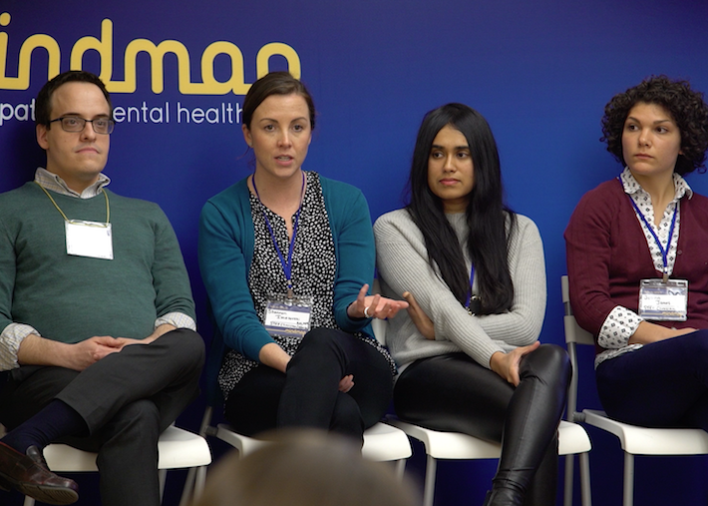
Community Outreach
2 Special Events
11 Workshops
15 Community Events
A gathering of community stakeholders and mental health professionals to build awareness of psychosis, early treatment, and the MindMap campaign.
These events included the MindMap Campaign Kick-off and the MindMap One Year Anniversary Party/Art Show.
MindMap had a presence 13 events in the community such as Mental Health Month Run and Fresh Check Days.

Slide 23
3. Rapid Access to STEP (RAS)
Sticky handoffs, performance improvement tactics
Quick screening & triage
Separate RAS & FES teams
‘Relationship management’ with all POD groups
Screening within 1 working day and admission within 1 week
‘Pre-referral’ support for parents/caregivers/friends & others
Continuous audit of delay from screening to enrollment as part of PDSA cycles
Ferrara M, et al Psychiatric Services, 2022

Slide 24
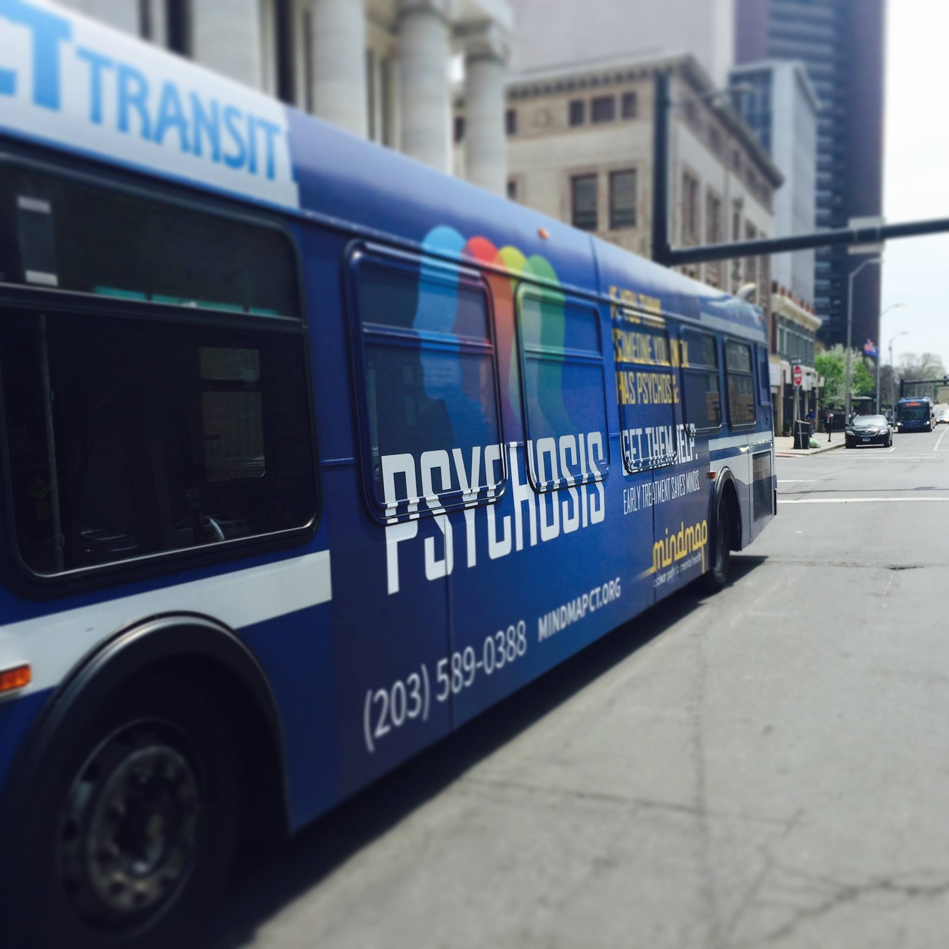
Did Mindmap work?
Median Total DUP at STEP
311.5 | 149 Days
44.5 | 21 Weeks
~10 | ~ 5 Months
Srihari et al., Early Detection of First-Episode Psychosis in a U.S. community: A Nonrandomized Controlled Trial (Under review)

Slide 25
Psychosis Onset to FES: SHORTENED BY HOW MUCH?
(Median DUP-Total at STEP)
(Median DUP RAISE)
(Median DUP at TIPS)*
311.5 | 149 Days
44.5 | 21 Weeks
~10 | ~ 5 Months
74 weeks (~ 61 weeks at PREP)
10 | 5 Weeks (16 at control site)
*2nd quartile reduction at TIPS of 11 weeks vs 8 weeks at STEP
Ferrara et al. Schiz Research 2019
Srihari et al., Reducing the Duration of Untreated Psychosis (DUP) in a US Community: A Quasi-Experimental Trial. Schizophrenia Bulletin Open, Volume 3, Issue 1, January 2022

Slide 26
What happens to a person with recent onset psychosis in
Greater New Haven? Pathways through the regional Network
Mathis et al . Granular analysis of pathways to care and durations of untreated psychosis (PLOS ONE, 2022)

Slide 27
Notes:
6 sessions are organized around STEP’s care pathway

Slide 28
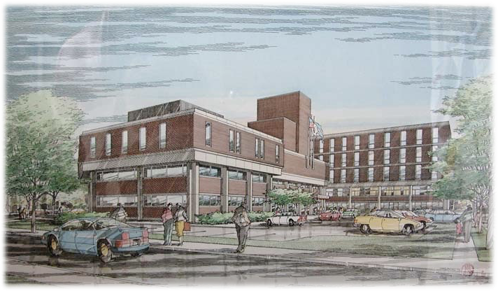
Summary
STEP has tested and demonstrated services that can both improve quality AND access across a defined catchment
This CT based public-academic partnership has influenced national policy (SAMHSA) driving CSC implementation and has been the first to demonstrate DUP reduction
Can we leverage this toward unmet need statewide?

Slide 29
Early Intervention Services
A System of care for CT

Slide 30
Offerings so far…
Workforce development and community education
http://www.ctearlypsychosisnetwork.org
for Behavioral Health Providers:
“Overview of EIS for Schizophrenia” 6-week Course
Early Psychosis ECHO - Case Discussions and brief didactics
Webinars – topics in clinical management
STEP Consult service
for Community:
Family and community workshops
Virtual library of resources

Slide 31
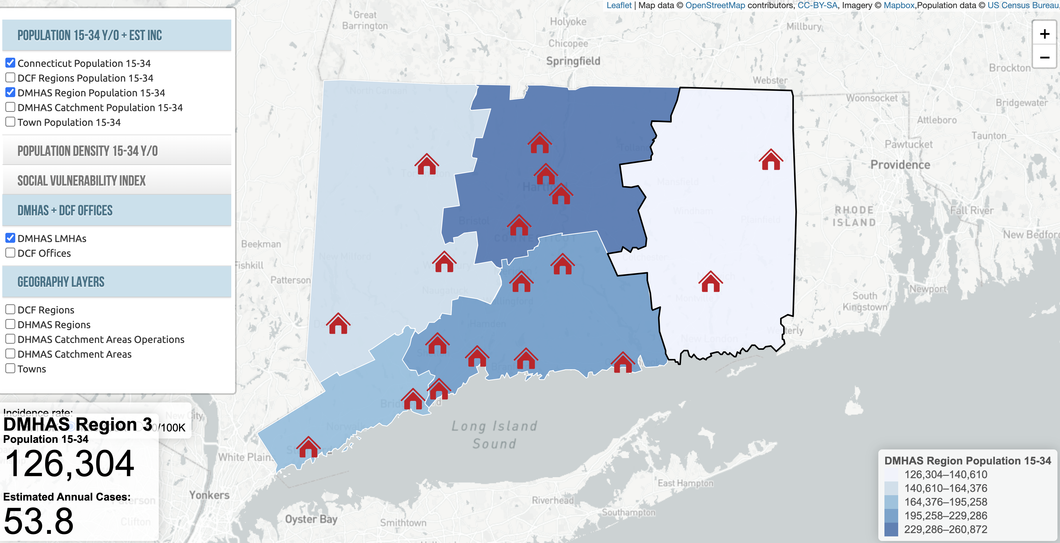
Developing a System of care for CT
http://stanmathis.pythonanywhere.com/STEP

Slide 32
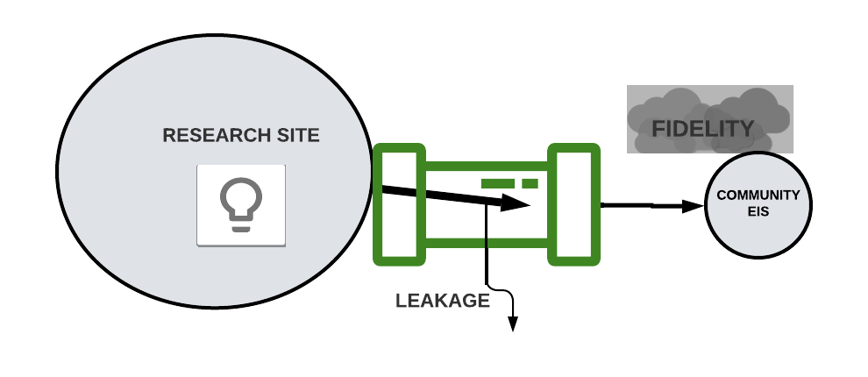
How (not) to disseminate: The pipeline approach
Srihari & Jani, 2016; Srihari & Cahill, 2020
Notes:
Implementation pipelines are good for polio vaccines (3 drops, active ingredients can be isolated) but a bad guiding metaphor for most chronic illnesses and for delivery of complex treatments (more on this later)
(Not Bob H’s necessary ‘knowledge’ pipeline) of research development to synthesis to guidelines

Slide 33
The Solution: Learning Health Systems (or Networks or Collaboratives)
A Learning Health System occurs when “science, informatics, incentives, and culture are aligned for continuous improvement and innovation...and new knowledge is captured as an integral by-product of the care experience”
Roundtable on Value and Science-Driven Health Care, Institute of Medicine. National Academies Press (US); 2013
Notes:
-What is feasible is not just how short the list is, or how long it takes to complete, but also the informatics platform and the culture of care, use of data/feedback: this is aiming for transformation not settling for current barriers…
-Networks should allow for longer term relationships, iterative discussions over time to (re)solve domains, variables, measures, procedures etc.

Slide 34
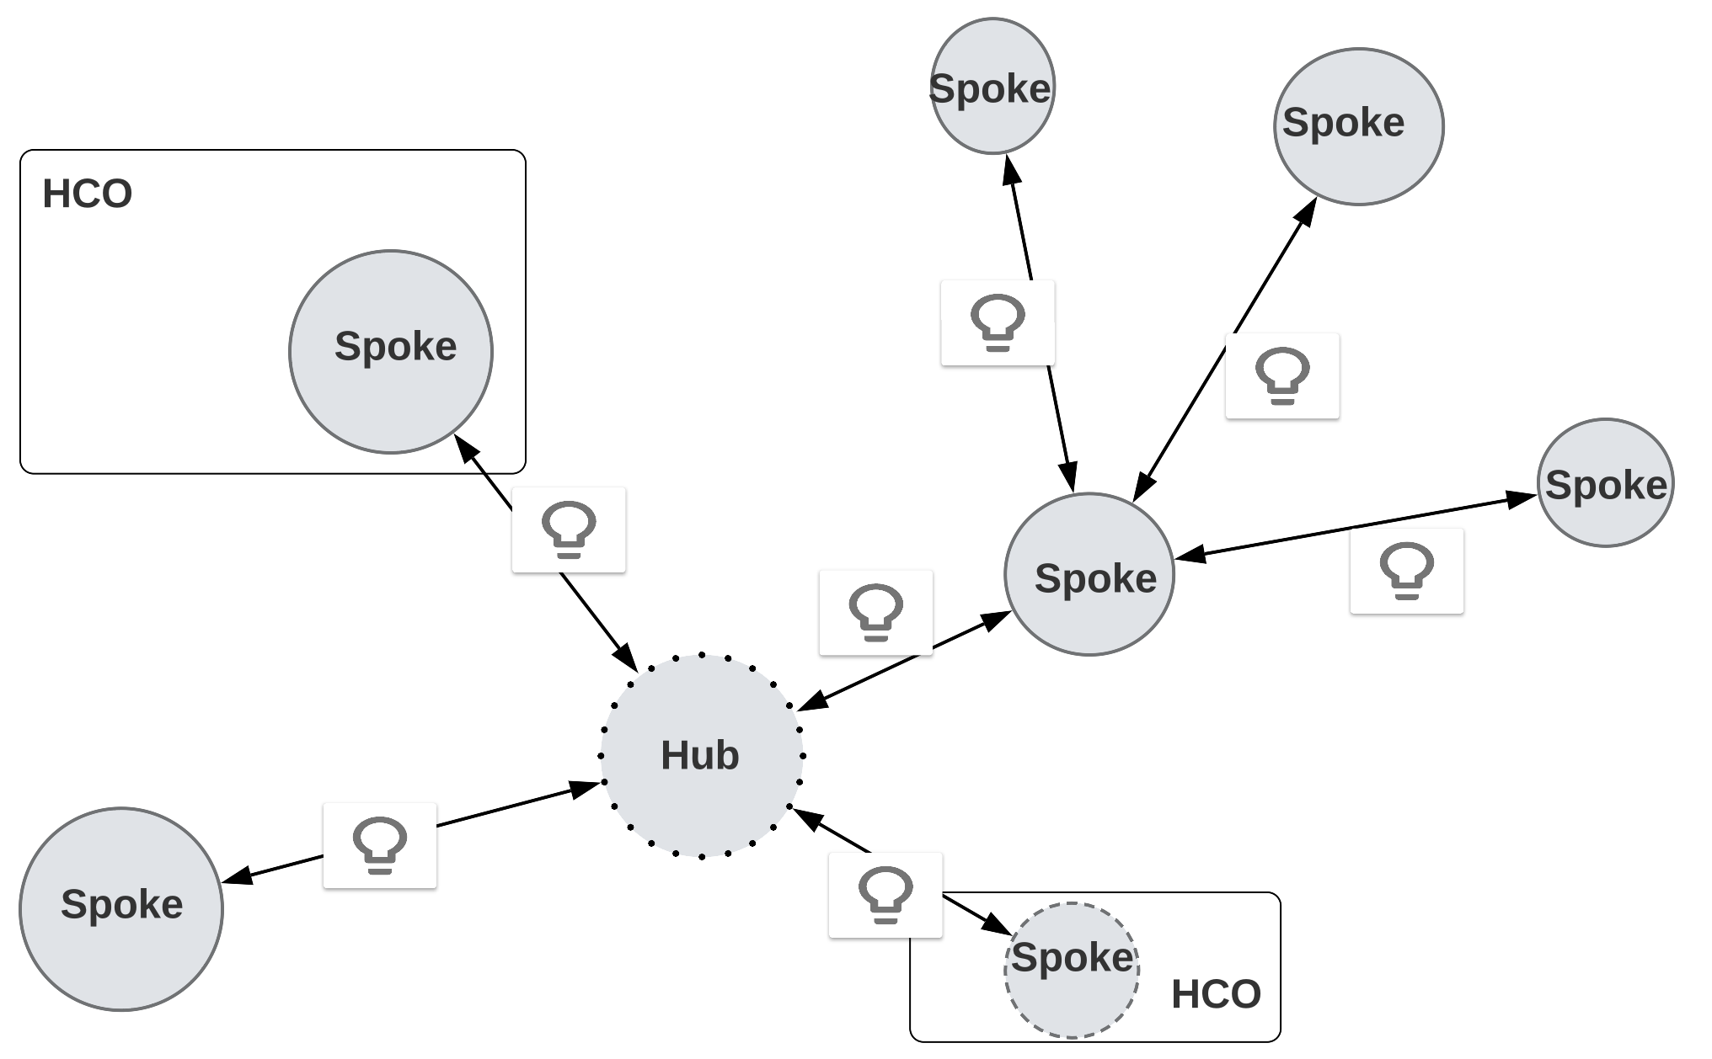
Disseminating via an LHC: Flexible structures, processes with shared goals

Slide 35
Connecticut’s LHC for FEP
PURPOSE: for all persons with schizophrenia to live fulfilling lives
WHAT: To transform access and quality of care for all individuals with recent onset schizophrenia* and deliver outcomes benchmarked to international standards.
WHO: All stakeholders – clinical and community
HOW: Via a statewide Learning Health Network (STEP-LHC)
*Residents of CT 16-35yo and within ~ 3yrs of psychosis onset. All insurance plans (or none)
www.step.yale.edu; www.ctearlypsychosisnetwork.org

Slide 36
Developing a Learning Health System across Connecticut
in CT
Phase 1: ACCESS
Goal is to improve local pathways to care (PTC) and reduce the Duration of Untreated Psychosis (DUP) across all 5 Regions of the state
Establish the skeleton of a statewide LHN (structure, processes, culture)
Establish workflows for data collection, analysis and review
Establish Quality Improvement workflows to improve quality of pathways, reduce quantity of delay and improve engagement with services
Phase 2: QUALITY
Goal is to improve population health outcomes of treated patients across all 5 Regions of the state
Establish standardized collection of outcomes across key population health metrics
Share lessons and resources across LHN to improve outcomes within a QI framework
Disseminate new treatments emerging from research across LHN
…….

Slide 37
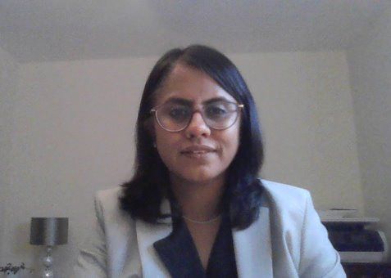
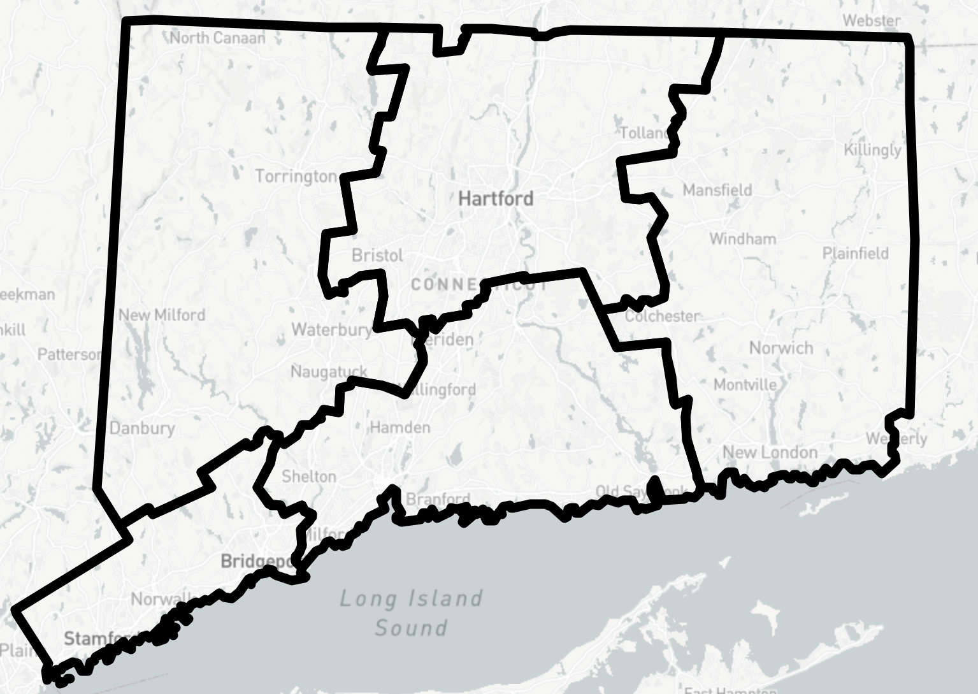
Introducing Early Detection and Assessment Coordinators
Region 4
Region 5
Region 3
Dr. Sneha Karmani
sneha.karmani@yale.edu
Region 2
Toni Gibbs-Dean, PhD
toni.gibbs-dean@yale.edu
Region 1
Sumeyra Tayfur, PhD
sumeyra.tayfur@yale.edu
Philip Markovich
philip.markovich@yale.edu

Slide 38
What we are aiming for
To improve outcomes for individuals experiencing symptoms of psychosis by intervening early in illness
Understand
Step 1. Develop an understanding of service operations and processes for people with early psychosis
Support
Step 2. To provide a suite of clinically relevant tools to help improve early detection and assessment pathways for people experiencing psychosis

Slide 39
LMHA
Individual experiences symptoms of psychosis
Directly contacting LMHA
Inpatient
Educational facility
Police/justice system
Other…

Slide 40
EDAC Referral Line
(203) 589-0388
Referral via EDAC referral line*
EDAC brief assessment
LMHA treatment
EDAC follow up
Eligibility for our initiative:
FEP (3yrs)
Not in services
16-35yrs
Consent
To provide overview of symptoms, demographics and service outcomes.
Assist with engagement to local LMHA
3 months:
Did they engage?
Can we support this process further?
EDAC + LMHA point of meeting
Signposting to their local LMHA
Ineligible individuals will be signposted to the appropriate service
Full assessment made available to LMHA

Slide 41
What are we offering to LMHAs
Nope!
Clinical intervention (although we can support via STEP-Consult Service)
Yes
A way to begin to better understand help-seeking in your region
High quality data about referred individuals with FEP, pathways to care and service engagement
Not yet
Changes in care delivery structures or processes
A new service (like STEP)
Support in engagement of patients to increase chances of earlier intervention
Training & Consultation
Referral line (for psychosis but also other mental health concerns)
Any sort of interference with established referral and treatment pathways
Outcome measurement of patients treated in your clinics

Slide 42
EDAC Baseline Assessment
Zoom/ in-person
~ 90 minutes (single or multiple sittings)
Patient +/- caregiver (collateral information)
Follow up at 3 mo if engaged with care, assist as necessary

Slide 43
Scales included in the assessment
SCALE​ | OBJECTIVE​ | COLLECTED FROM​
Demographics​ | Race/Gender/Ethnicity/Immigration Status/Location/Age/Socio-economic status​ | Patient/Family​
Treatment Status Form​ | Inpatient (psychiatric or substance use), outpatient and legal issues​ | Patient/Family​
Structured Interview for Prodromal Syndromes (mini-SIPS)​ | To date the Onset of Psychosis and Clinical High-Risk state.​ | Patient​
Positive and Negative Syndrome Scale (PANSS)​ | Symptom severity​ | Patient​
Pathways to Care (PTC)​ | Tracks all help-seeking efforts within pathway to care after CHR onset.​ | Patient/Family​
GF Role/Social ​ | Role and Social functioning​ | Patient​
Global Assessment of Function (GAF)​ | Current and 12-month prior assessment of social, role and psychological functioning ​ | Patient​
Alcohol and Drug Use Scale (AUS/DUS) & Cannabis Scale​ | Substances and mode of use​ | Patient ​

